Slide 1
Driver Safety and Drowsiness Detection System
A driver safety feature for low end vehicle users…
Wijekoon Somasiri -170001510
Herath Premaratne -1700017825

Slide 2
Problem Identification
Road death statistics from 2011 – 2018 in New Zealand
284 to 393
Reported injuries from 2012 – 2017 in New Zealand
11,000 to 13,000
Reasons
Lost control of vehicle
Speeding
Alcohol
Driver Drowsiness
Weather and Vehicle conditions
Ministry of Transport, New Zealand (2018)

Slide 3
Solution and Research Question
improving the automobile safety practices using computer vision and low-cost hardware
improving the automobile safety practices by monitoring facial gestures of human

Slide 4
Aim
“develop user-friendly, efficient, accurate and low-cost application using image and video processing algorithms to detect driver drowsiness to reduce road accidents and increase driver safety”
Objectives
Research on the identified areas relevant to the project and come up with the literature review. The literature review of the project consists of existing driver safety systems and its functionalities along with the comparison table of the existing systems.
Design the system architecture according to the gathered information from the research.
Implement the finalized design of the proposed system.
Test and evaluate the implemented system.
Submit the deliverables on time

Slide 5
Comparison of Existing Systems
Existing Systems | StopSleep - Electronic Anti-Sleep Alarm | Bosch Driver Drowsiness Detection | Anti-Sleep Pilot | Lane Departure Warning System | Drowsiness Detection system using EEG Helmets | Tesla Auto Pilot
Developed by | StopSleep Anti-Sleep Alarm PLC | Bosch Germany | ASP Technology Ltd, Denmark | Mercedes Benz | Ford Motor company | Tesla Inc.
Detection method | Skin heat | Steering patterns | Reactions by driver to random tests | Lane boundaries | Alpha activity of human brain | Monitor obstacles around the vehicle
Hardware devices | Eight sensors | Steering angle sensors | Light, sound and touch sensors | Camera | EEG electrode mounted helmet | Eight cameras and twelve ultrasonic sensors
Device Type | Portable | Not Portable | Not Portable | Not Portable | Portable | Not Portable
Alerting Method | Vibrating the device, output light and sound | Flashing a coffee cup sign in the system | Sound | Flashing a warning light with a beep sound | Vibrating helmet or the steering wheel with a sound | Control the car without human involvement
Market Price | 200 USD | - | 250 USD | 1000 USD and above | 500 – 1000 USD | 80,000 USD

Slide 6
Added Values
Low cost
Efficient and Accurate
User Friendly

Slide 7
Measurable Organizational Value
Reduce the number of road accidents by 20 percent in the first year of installation.
Take at least 500 customers aboard within the first year
Increase the customer base by 10 percent each year
Impacts
Social
Customer
Finance

Slide 8
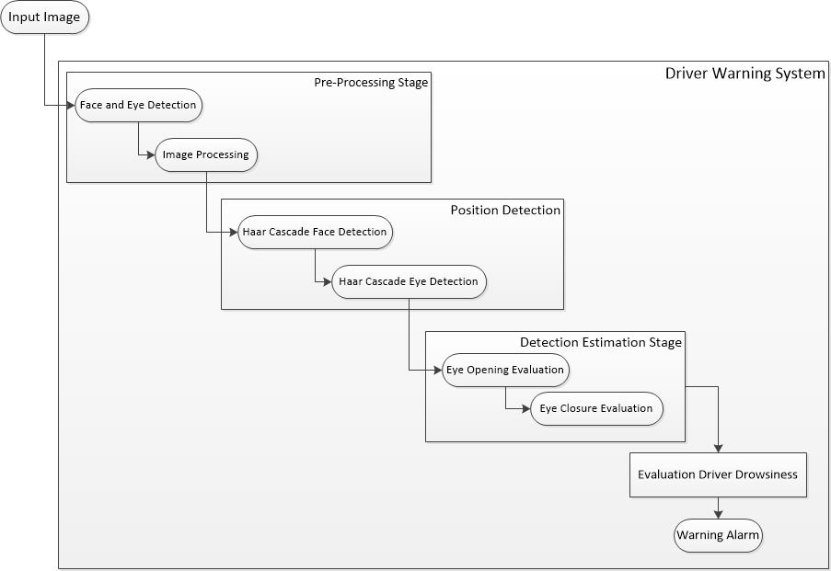
Design

Slide 9
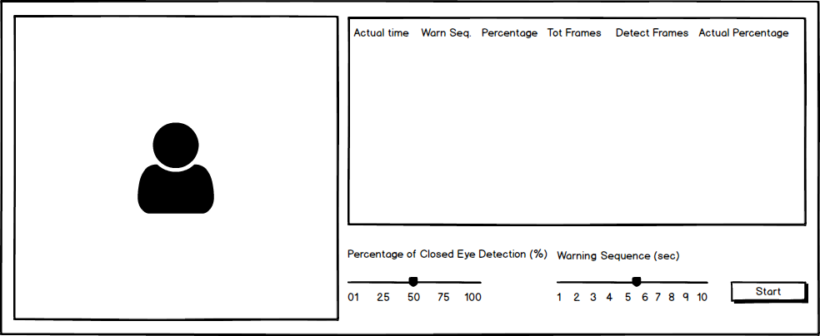
Prototype User Interface Wireframe

Slide 10
SOFTWARE DEVELOPMENT METHODOLOGY
Agile Values
1. Individuals and interactions over processes and tools
2. Working software over comprehensive documentation
3. Customer collaboration over contract negotiation
4. Responding to change rather than following a plan
Extreme programming
Pair programming
Spike Game
Pre planning
3 – 4 days sprint cycles

Slide 11
Questions
and
Answers

Slide 12
Thank You

